Slide 1
Architecting Context: An Introduction to Model Context Protocol
Frank Kovacs @statkovacs frank-Kovacs.net

Slide 2
Goals
Define MCP
MCP Components
How it works

Slide 3
Caveats
LLM Specific
Released in November 2024
https://frank-kovacs.net/projects/mcp_nycr/

Slide 4

About Me
Former Senior data engineer at consulting firm
ETL → Data Science → AI / Architecture
$60M+ in value-add projects
Previous: MS and BS at Carnegie Mellon University, 2019 + 2021
Local to the tri-state area

Slide 5
Framing
“The true power of AI lies not in replacing humans, but in working alongside us to achieve what neither can do alone. ” -Sebastian Thurn
“Surprisingly, we find that when developers use AI tools, they take 19% longer than without—AI makes them slower.” (Becker, Rush, Barnes and Rein, 2025)

Slide 6
Example LLM Workflow: Basic
Construct prompt
LLM “Black Box”

Slide 7
Example LLM Workflow: Basic Drawbacks
Tool Specification
Knowledge cutoff

Slide 8
Example LLM Workflow: Basic Drawbacks
Tool Specification
Knowledge cutoff
Time-consuming
Dubious security
Labor-intensive: N by M Integration Problem

Slide 9
Definitions
Model Context Protocol – An extension of the client / server architecture pattern that provides a standardized way for models to interact with functions and static resources.

Slide 10
Use cases
Non-public APIs
Proprietary data sources
More reliable information
Faster development

Slide 11
Benefits
Standardized communication
Client / Server benefits
Piecewise across servers
Bespoke: Additional context

Slide 12
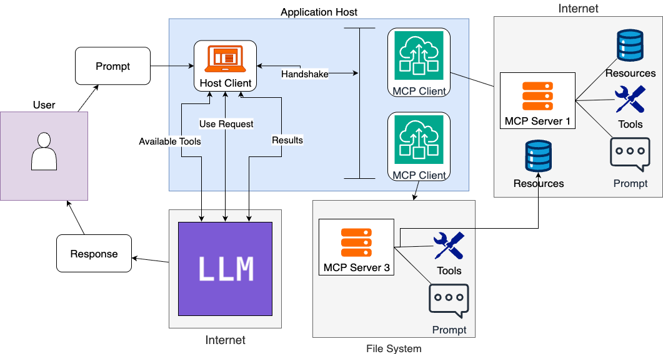
MCP Diagram

Slide 13
MCP Defined
Components
  Application Host
    Client: Within Host
  Server
Layers
  Data Layer
  Transport Layer

Slide 14
Aside: Client / Server Architecture
Client / Server Architecture – A distributed compute model in which the client(s) request data from a server: ask / answer

Slide 15
MCP Components: Application Host
Application Host – The application that the user interacts with.

Slide 16
MCP Diagram

Slide 17
MCP Components: MCP Client
MCP Client – Piece of code within application host that negotiates communication with a server
  1:1 relationship with server
  Spawned within application host

Slide 18
MCP Diagram

Slide 19
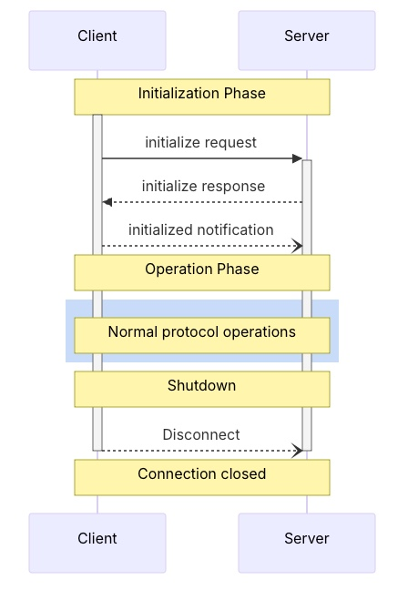
MCP Components: Client Lifecycle
Initialization
  Negotiate capabilities
  Initiated by client as standalone
Operation
Shutdown
  Initiated by client

Slide 20
MCP Components: Client Functionality
Sampling – Servers requesting completions from clients
Roots – Specify files
Elicitation – Request specific information from end user during execution

Slide 21
Client code sample

Slide 22
MCP Components: MCP Server
MCP Server – Expose the AI model to outside functionality
  Authentication sometimes needed

Slide 23
MCP Server Functionality
Tools – Functions that can be called by the LLM
Prompts – Templates called by the user stored on server
Resources – Read-only data sources for additional context. Controlled by application

Slide 24
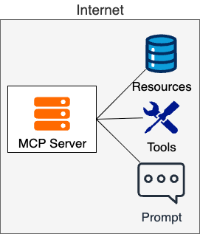
MCP Server Architecture
Separation of concerns
Single responsibility

Slide 25
MCP Layers: Data Layer
Data Layer Protocol – Message structure and semantics between client and server

Slide 26
MCP Data Layer Reference
Tools
List
List
Prompts
Call
Resources
Read
Subscribe
List
Get
List / Template

Slide 27
MCP Layers: Transport Layer
Transport Layer – Connection establishment and security, “the how”
  Stdio transport: Local
  Http: POST with standard authorization

Slide 28
MCP Diagram

Slide 29
Code Demo

Slide 30
MCP Execution Steps
1. User request to application host
2. Client initiates server connection
3A. Model receives tool list
Model uses tool
Model does not use tools
4. Returns answer
4. Model returns structured call
3B. Model receives resource list
Model does not use resources
Model returns answer
Model does use resources
4. Request to client

Slide 31
Step 4 Zoom-In: Tools & Resources
Tools / Resources defined as follows:
  Name: Primary key for execution
  Title: Human-readable
  Description: Primarily used to determine usefulness
  (Tools only): Input and output specification

Slide 32
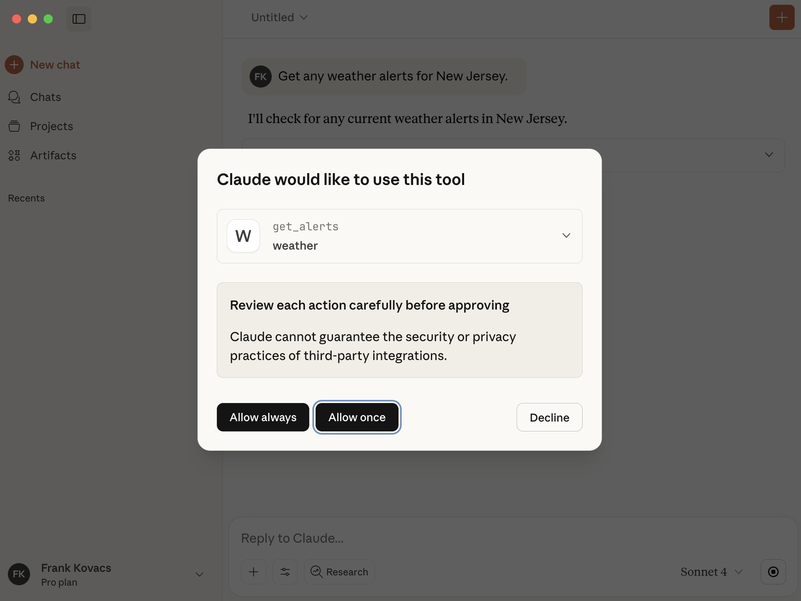
Step 4 Example

Slide 33
Aside: Agent vs. Workflow
Workflow - Deterministic, pre-defined
Agent – Non-deterministic, LLM as a black box

Slide 34
Demo

Slide 35
Recap
MCP is a protocol that enables LLMs to access tools, resources and prompts
Agentic vs. workflow constructions
Standardization
Implementation: Server first
Client within application host

Slide 36
FAQ
RAG vs. MCP: Two different ballgames
Necessary? No. Helpful? Yes
First move advantage

Slide 37
Questions

Slide 38
Thank you!

